Slide 1




AT82.02
Data Modeling and Management
Lab8: NEO4J - Graph Model

Slide 2
Outline
Neo4J Graph database Overview
CRUD Operations
1. CREATE
1.1 Create Node
1.2. Create many Nodes and Relationships at once.
2. QUERY
2.1 Basic Query
2.2 Make Recommendations
2.3 Aggregate
3. UPDATE
3.1 Update Property of Node or Relationship
3.2 Update Label
4. DELETE
4.1 Delete a specific node
4.2 Delete a specific relationship
4.3 Remove Label from a node
4.4 Remove a property

Slide 3
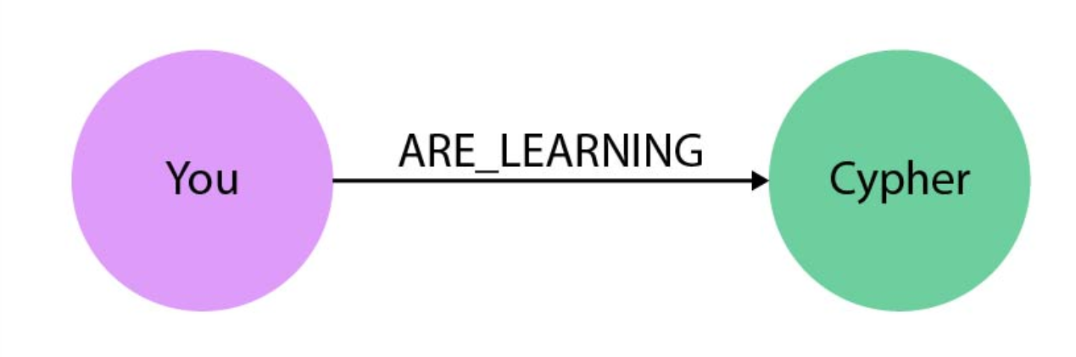


Slide 4
Neo4j is an open-source, NoSQL graph database.
Property Graph data model
Cypher Graph query language
Notes:
Neo4j, like many other graph databases, builds upon the property graph model;
labeled nodes are connected via directed, typed relationships.
Both nodes and relationships hold arbitrary properties (key-value pairs).
There is no rigid schema, but with node-labels and relationship-types we can have as much meta-information as we like.
The relationships are treated with as much value as the database records themselves.
This allows the engine to navigate your connections between nodes in constant time.
That compares favorably to the exponential slowdown of many-JOIN SQL-queries in a relational database.

Slide 5
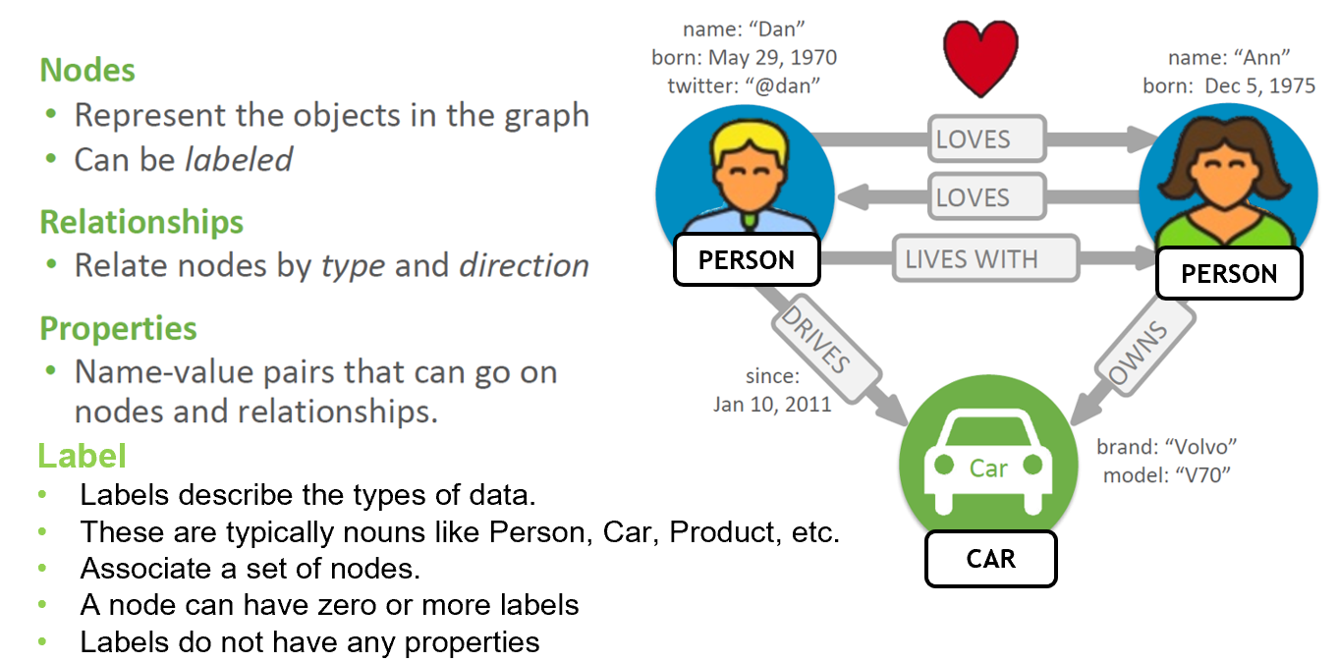
Property Graph Model

Slide 7
Cypher - Neo4j's graph query language
uses patterns to describe graph data
familiar SQL-like clauses
declarative, describing what to find, not how to find it

Slide 8
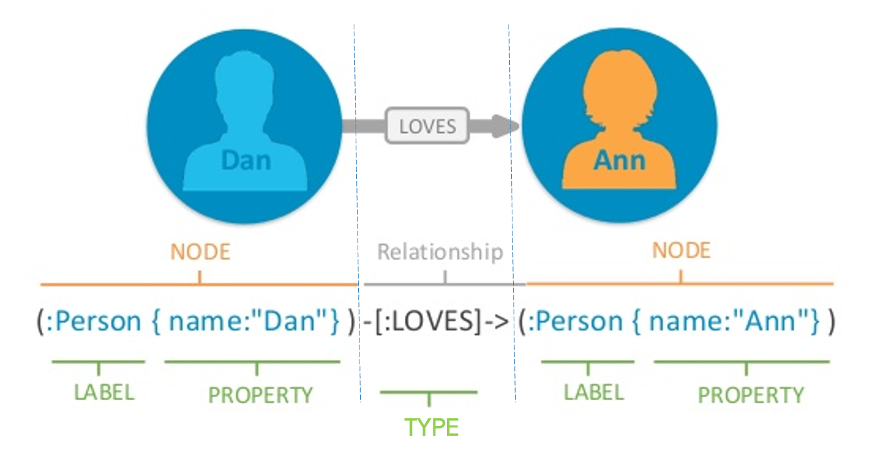
Pattern

Slide 9
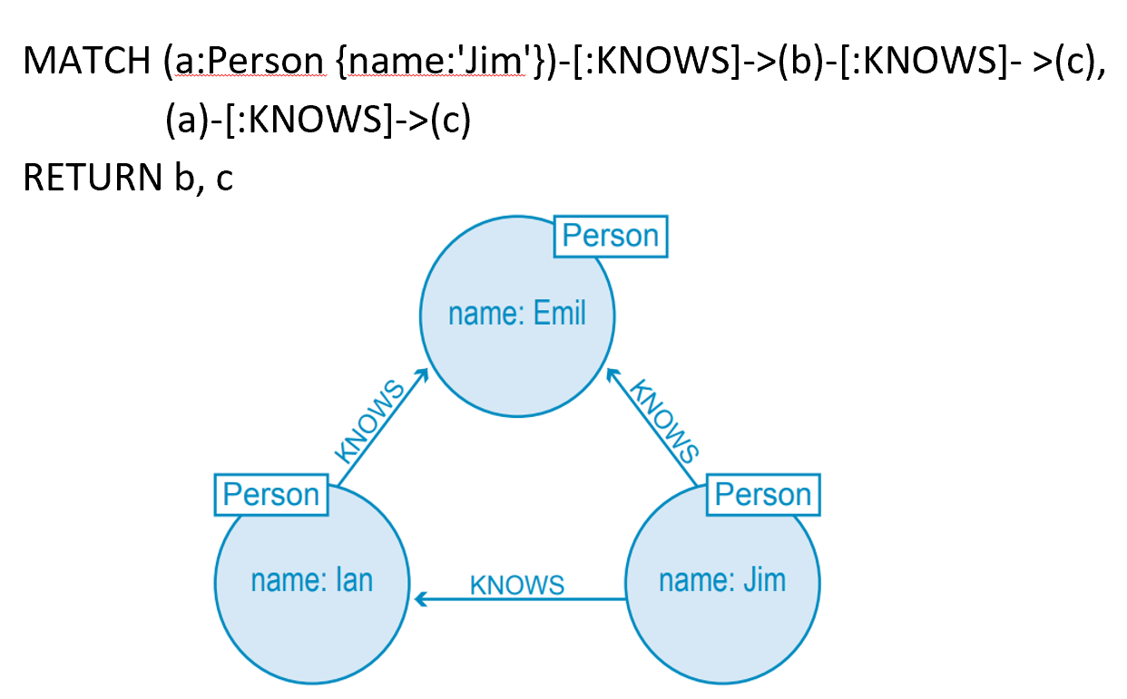
Example
Who is b?
Who is c?

Slide 10
CRUD operations
Create/Insert
Read/Query
Update
Delete

Slide 11
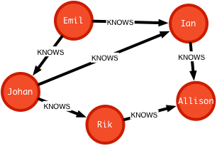
Scenario
Small Social Network Graph
- Emil KNOWS Johan and Ian
- Johan KNOWS Ian and Rik
- Rik and Ian KNOWS Allison

Slide 12
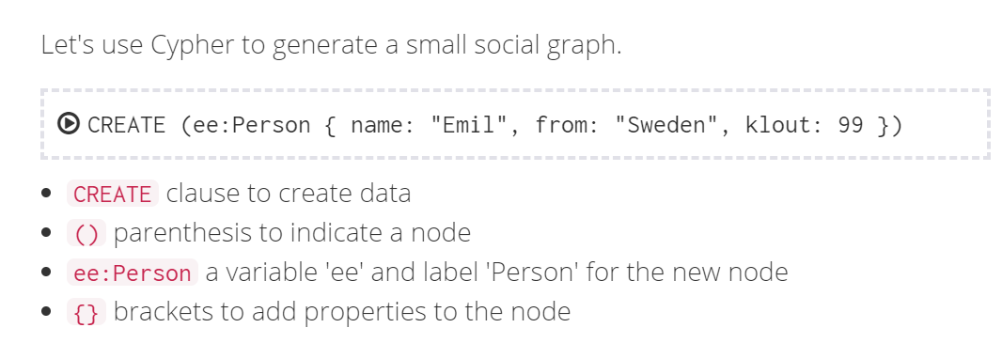
1. CREATE
1.1 Create Node

Slide 13
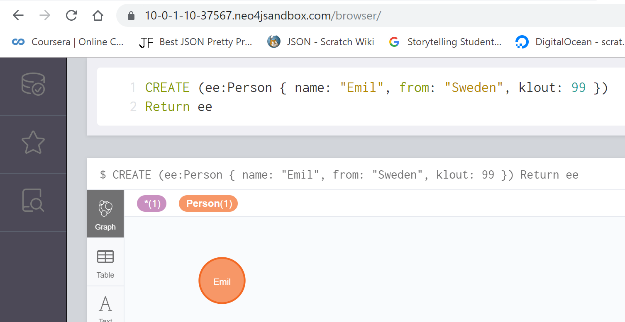
CREATE (ee:Person { name: "Emil", from: "Sweden", klout: 99 })
Return ee

Slide 14
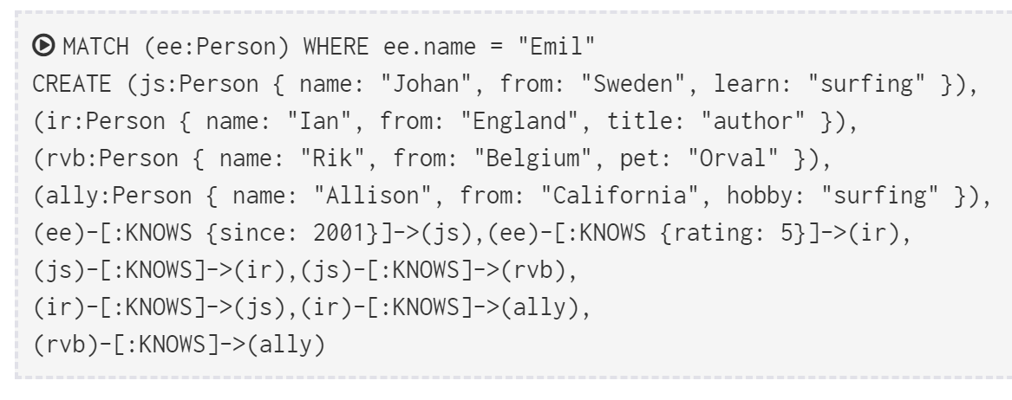
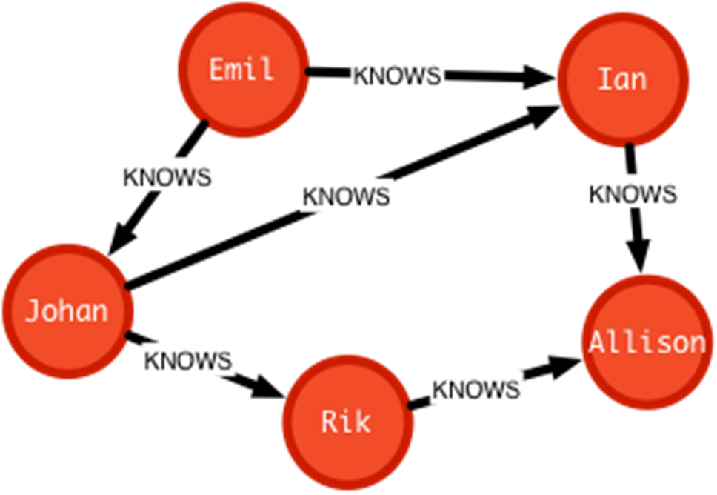
1.2. CREATE clauses can create many Nodes and Relationships at once.
MERGE
Notes:
MATCH (ee:Person) WHERE ee.name = "Emil"
CREATE (js:Person { name: "Johan", from: "Sweden", learn: "surfing" }),
(ir:Person { name: "Ian", from: "England", title: "author" }),
(rvb:Person { name: "Rik", from: "Belgium", pet: "Orval" }),
(ally:Person { name: "Allison",from: "California", hobby: "surfing" }),
(ee)-[:KNOWS {since: 2001}]->(js),(ee)-[:KNOWS {rating:5}]->(ir),
(js)-[:KNOWS]->(ir),(js)-[:KNOWS]->(rvb),
(ir)-[:KNOWS]->(js),(ir)-[:KNOWS]->(ally),
(rvb)-[:KNOWS]->(ally)

Slide 15
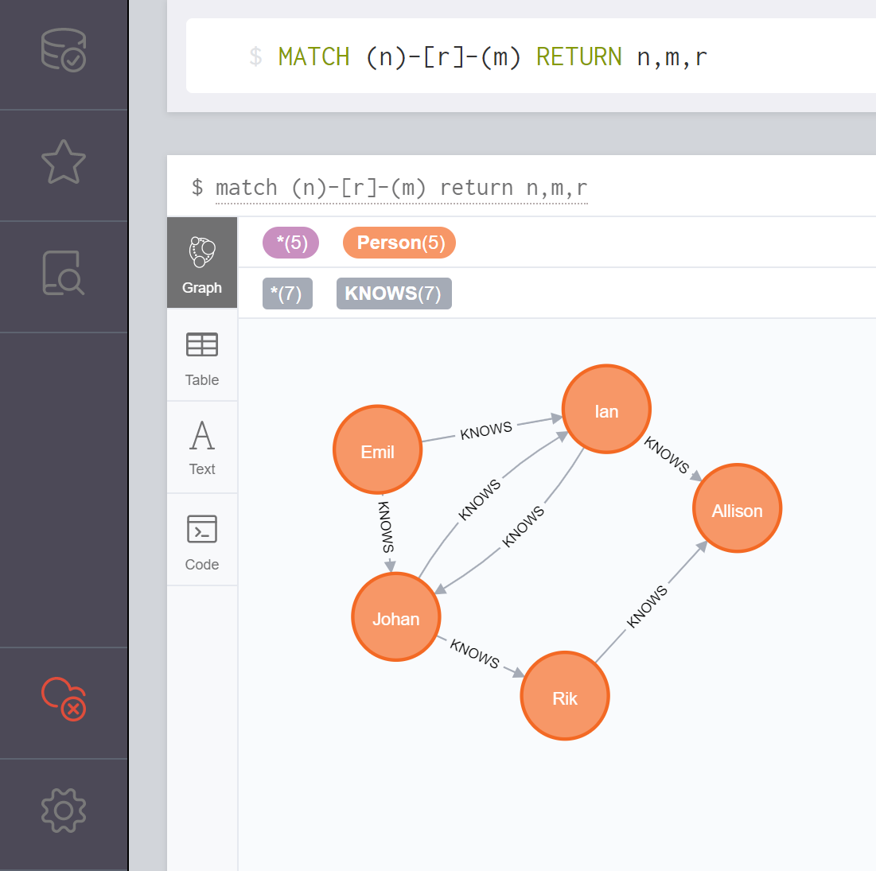
Verify by MATCH and RETURN
MATCH (n)-[r]-(m) RETURN n,m,r
means Show all Nodes and Relationships

Slide 16
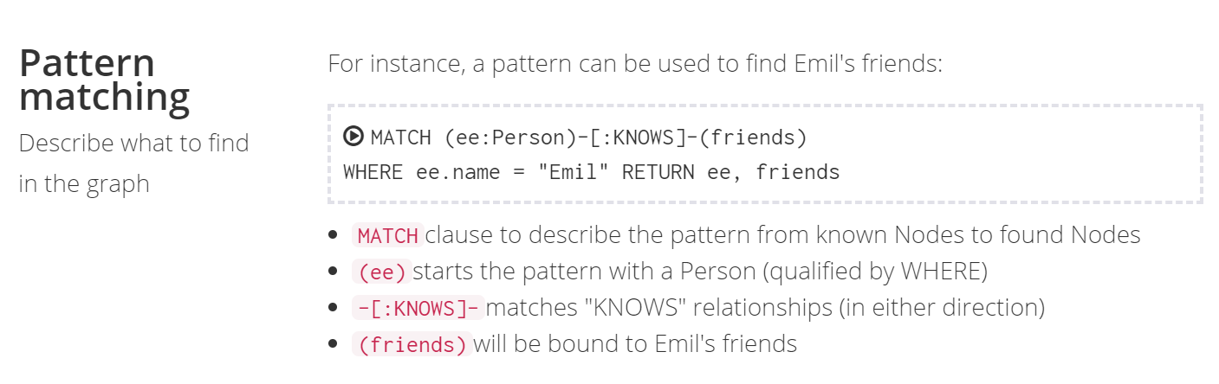
2. QUERY
2.1 Basic query the graph (Pattern matching )
EX.1 Find Emil’s Friends

Slide 17
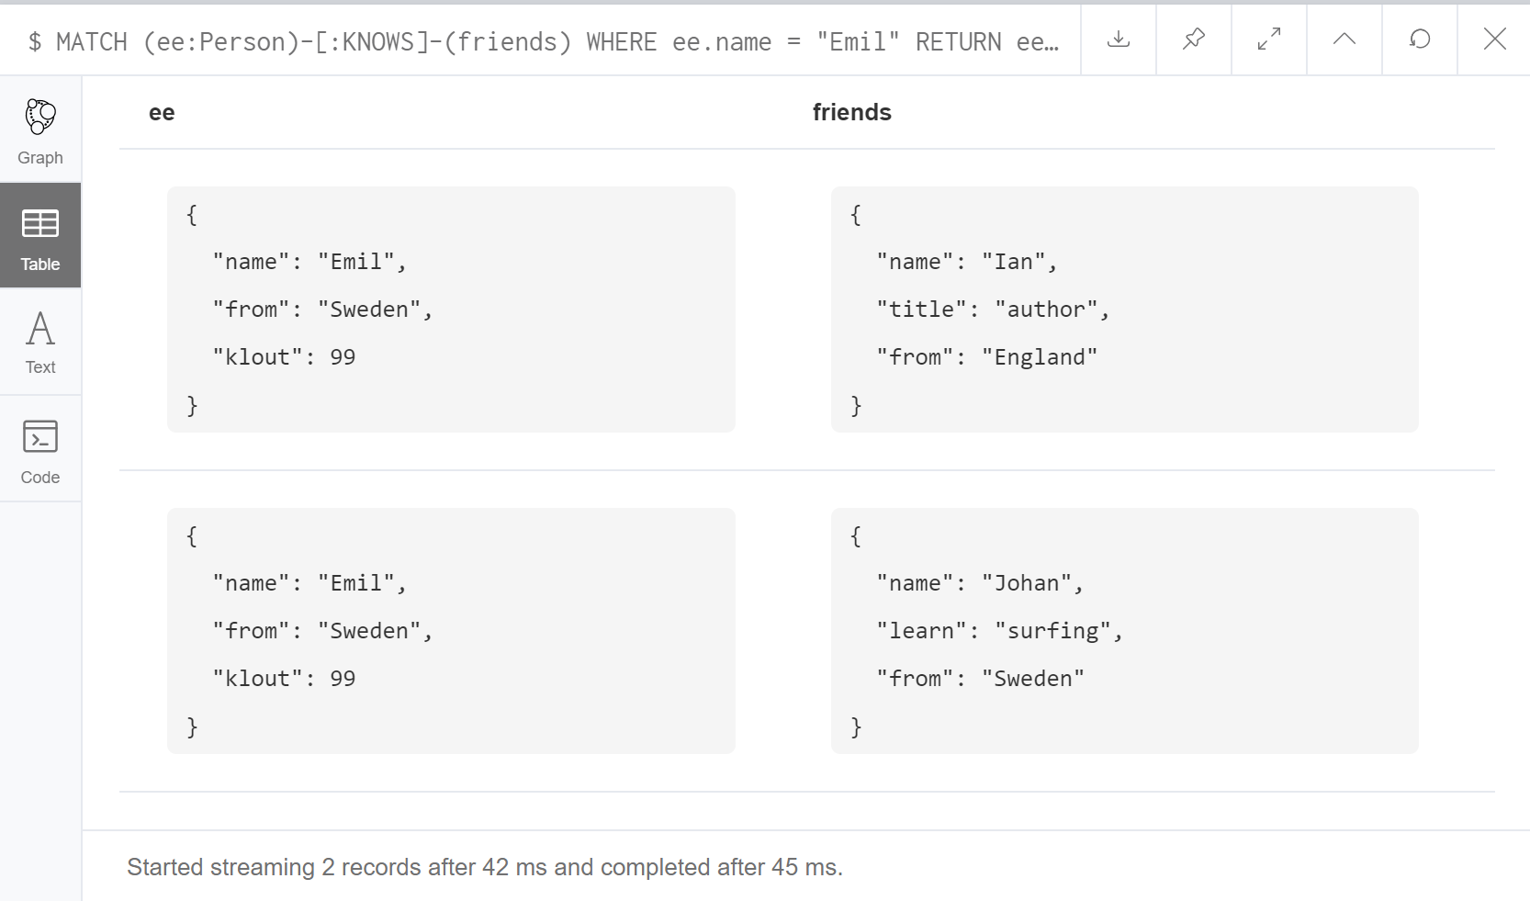
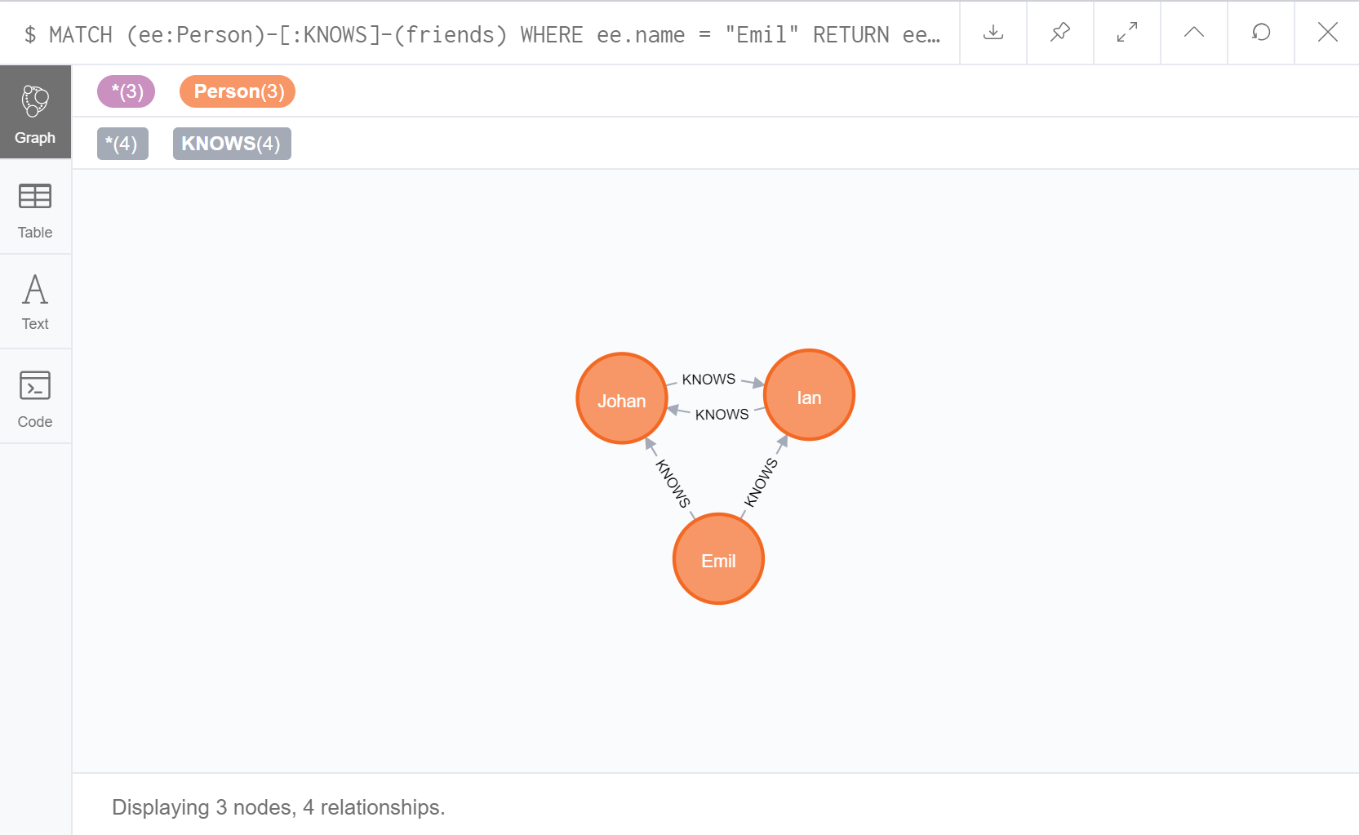
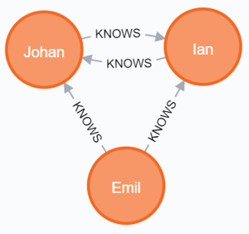
EX.2 Find Immediate Friends
MATCH (ee:Person)-[:KNOWS]-(friends)
WHERE ee.name = "Emil" RETURN ee, friends

Slide 18
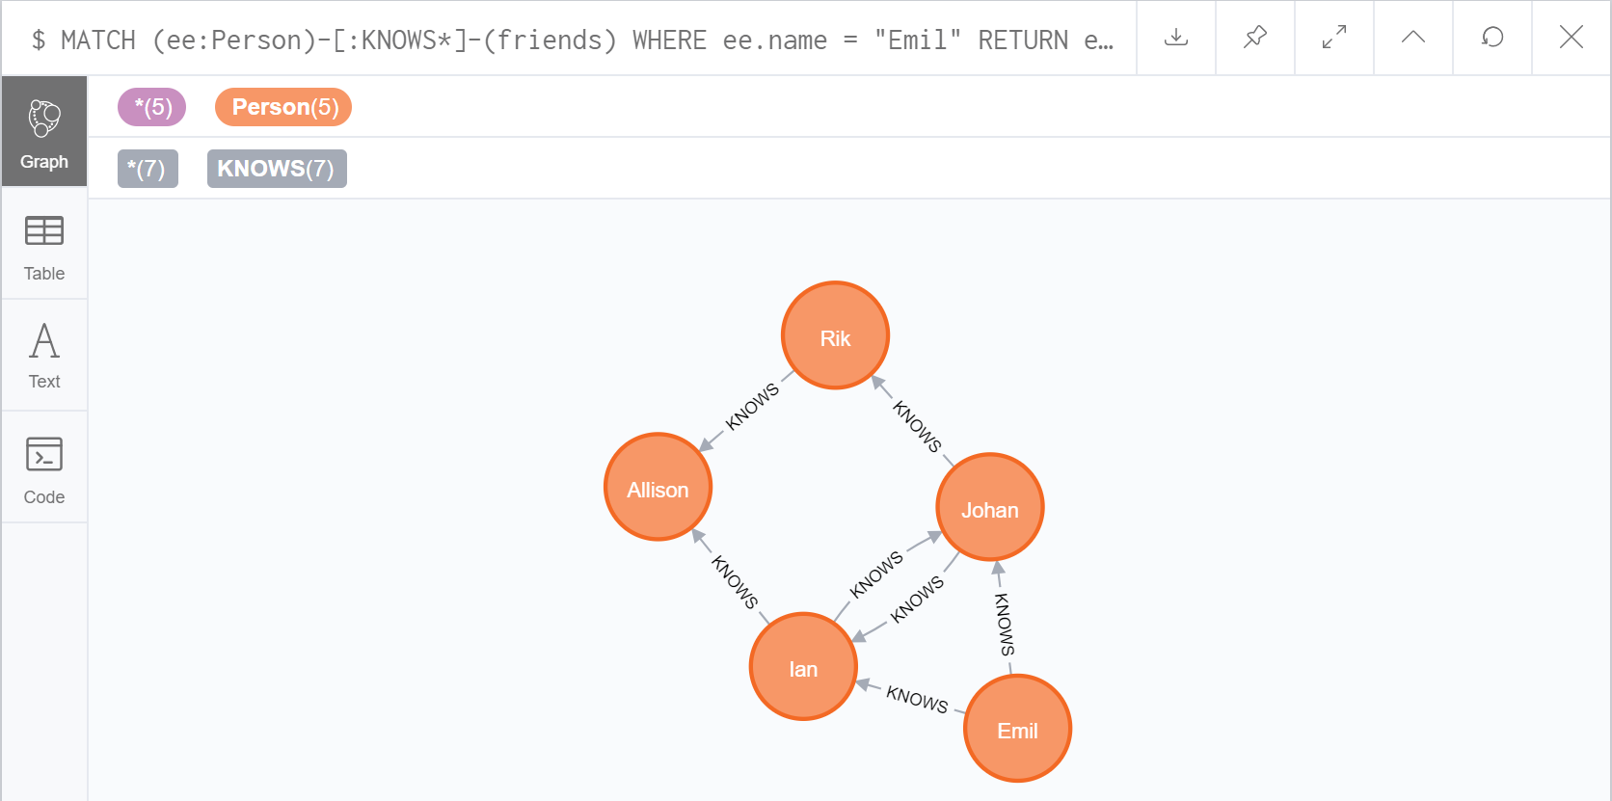
EX.3 Find Friends of Friends
MATCH (ee:Person)-[:KNOWS*]-(friends)
WHERE ee.name = "Emil" RETURN ee, friends

Slide 19
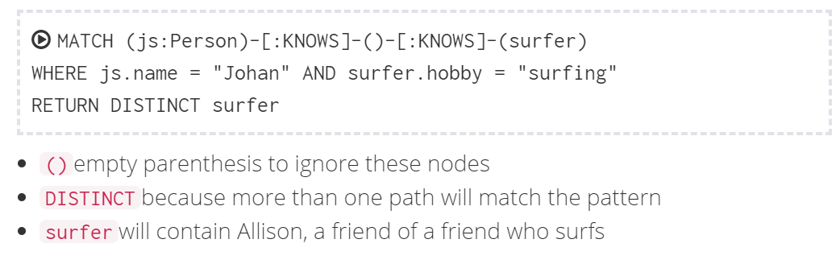
2.2 Make Recommendations (Pattern matching )
EX.4 Johan is learning to surf, so he may want to find a new friend who already does. Recommend him!!
Notes:
MATCH (js:Person)-[:KNOWS]-()-[:KNOWS]-(surfer)
WHERE js.name = "Johan" AND surfer.hobby = "surfing"
RETURN DISTINCT surfer

Slide 20
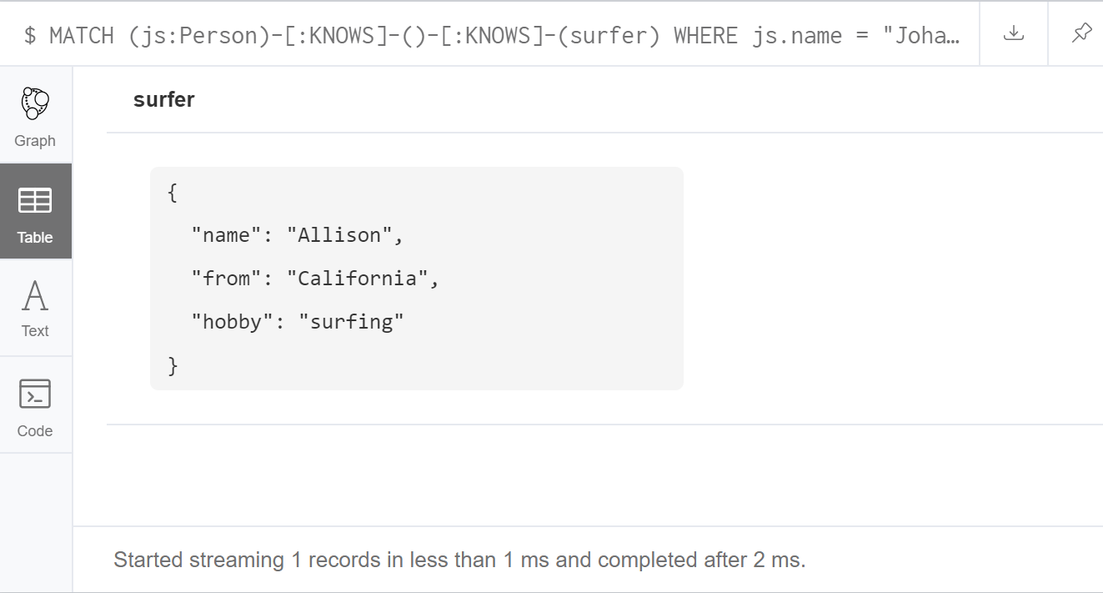
MATCH (js:Person)-[:KNOWS]-()-[:KNOWS]-(surfer)
WHERE js.name = "Johan" AND surfer.hobby = "surfing"
RETURN DISTINCT surfer

Slide 21
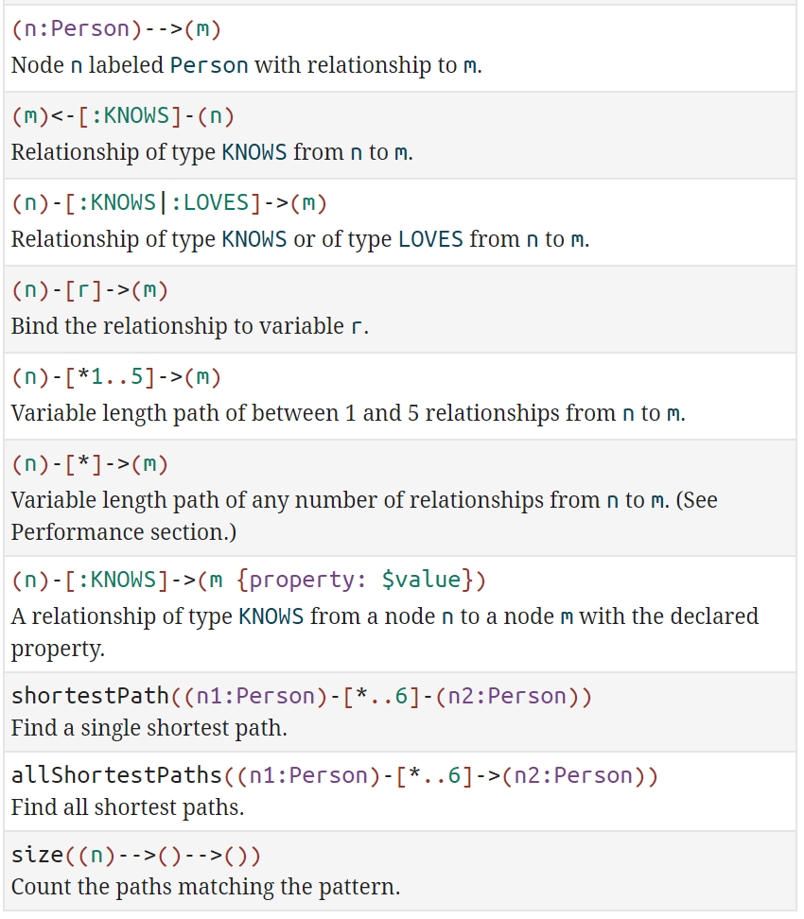
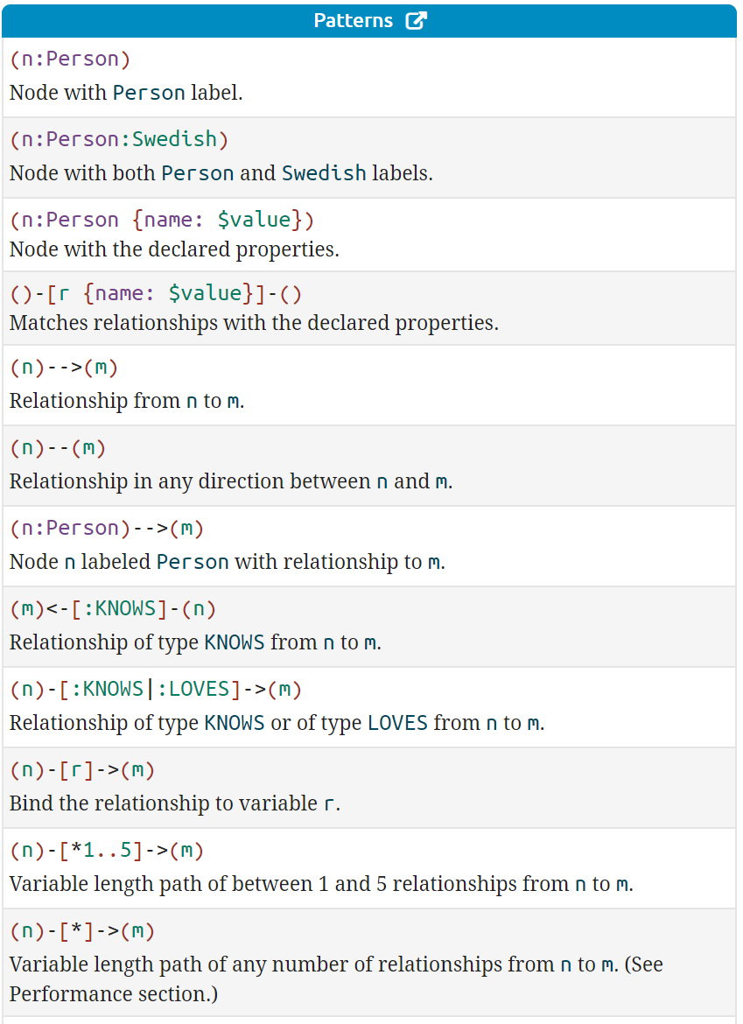
More Patterns
Notes:
https://neo4j.com/docs/cypher-refcard/current/?_ga=2.36519011.2100542366.1602562344-214533698.1600745849

Slide 22
EX.5 Johan is learning to surf, so he may want to find a new friend who already does. Recommend him Only the shortestPath
MATCH (js:Person)-[:KNOWS*]->(surfer)
WHERE js.name = "Johan" AND surfer.hobby = "surfing"
MATCH path = shortestPath((js)-[:KNOWS*]->(surfer) )
RETURN surfer, path
Warning: Using shortest path with an unbounded pattern will likely result in long execution times. It is recommended to use an upper limit to the number of node hops in your pattern. So, we change to
MATCH (js:Person)-[:KNOWS*]->(surfer)
WHERE js.name = "Johan" AND surfer.hobby = "surfing"
MATCH path = shortestPath((js)-[:KNOWS*..5]->(surfer) )
RETURN surfer, path

Slide 23
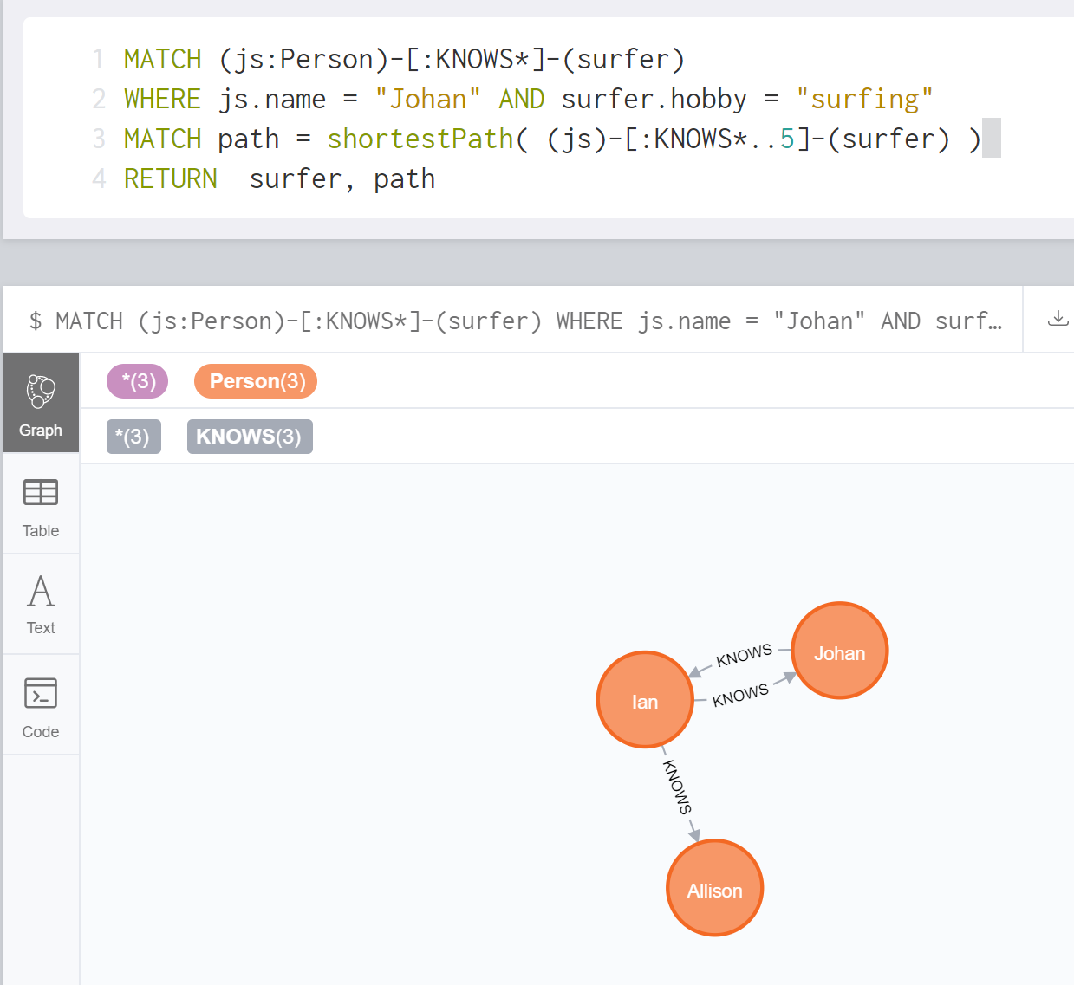

Slide 24
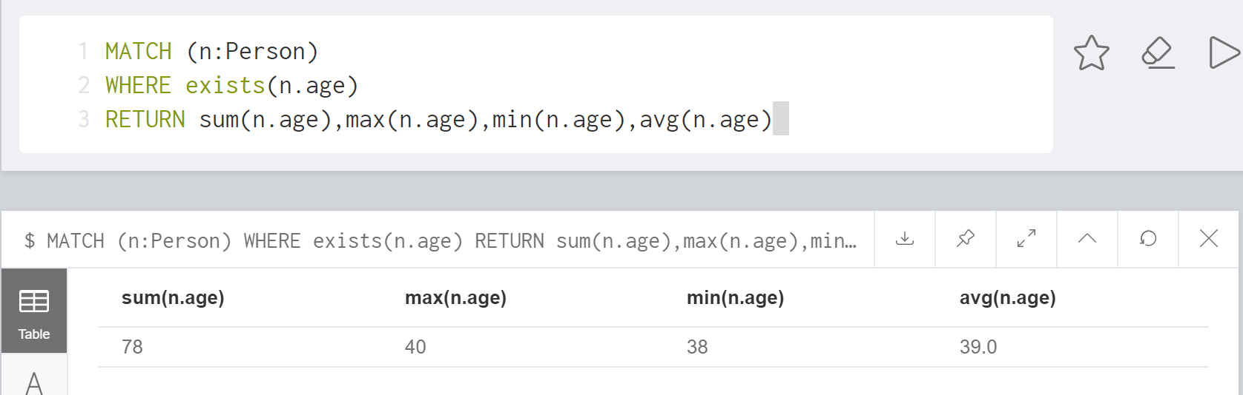
2.3 Aggregate
EX.6 Find Total, Average, Minimum, Maximum age of all people
MATCH (n:Person) WHERE exists(n.age)
RETURN sum(n.age),max(n.age),min(n.age),avg(n.age)
Notes:
MATCH (n:Person) WHERE exists(n.age) RETURN sum(n.age),max(n.age),min(n.age),avg(n.age)

Slide 25
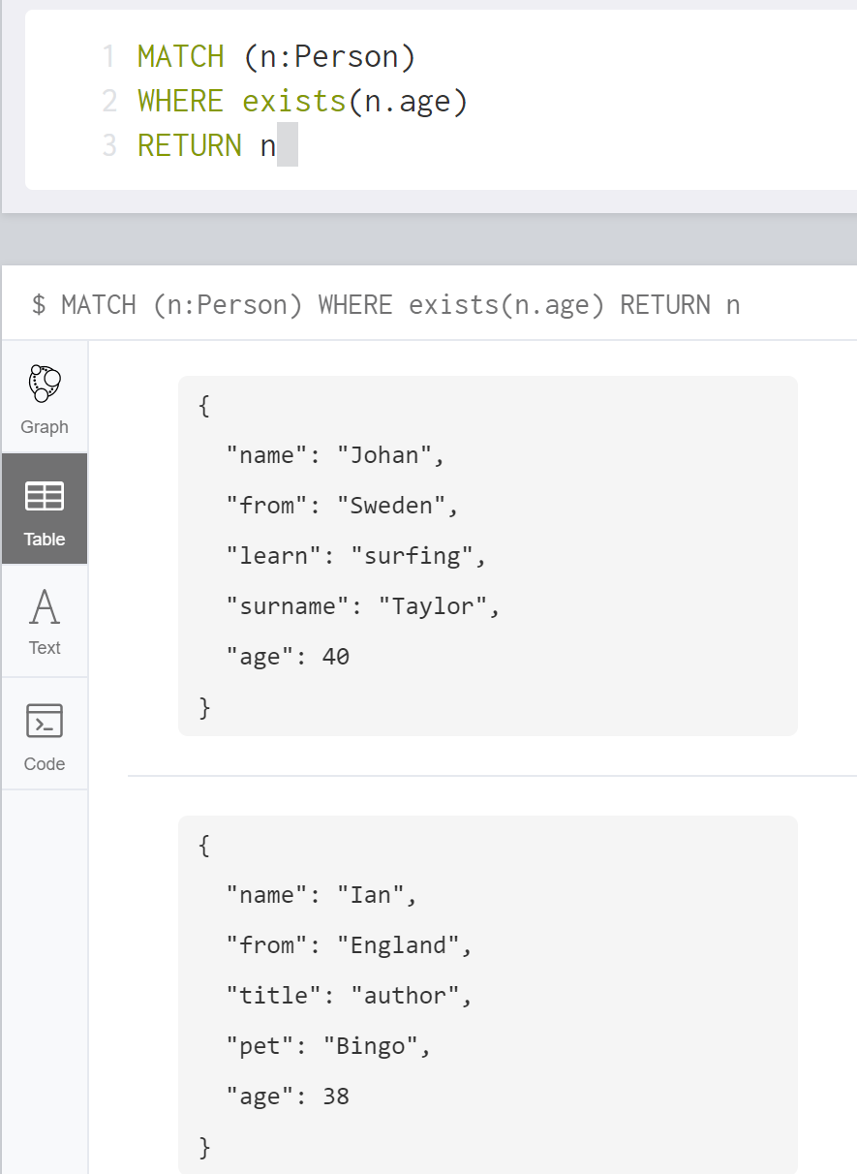
Note.

Slide 26
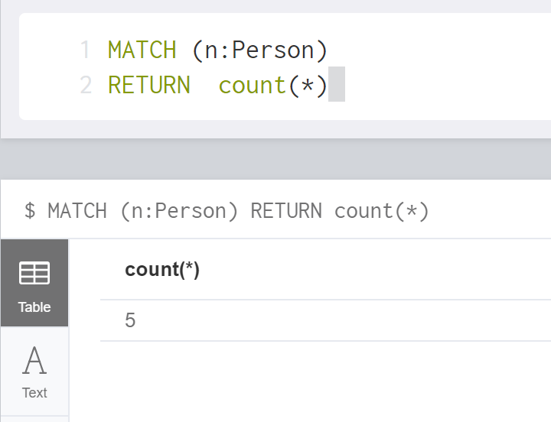
EX.7 Find Total number of persons
MATCH (n:Person) RETURN count(n)
Notes:
MATCH (n:Person) WHERE exists(n.age) RETURN sum(n.age),max(n.age),min(n.age),avg(n.age)

Slide 27
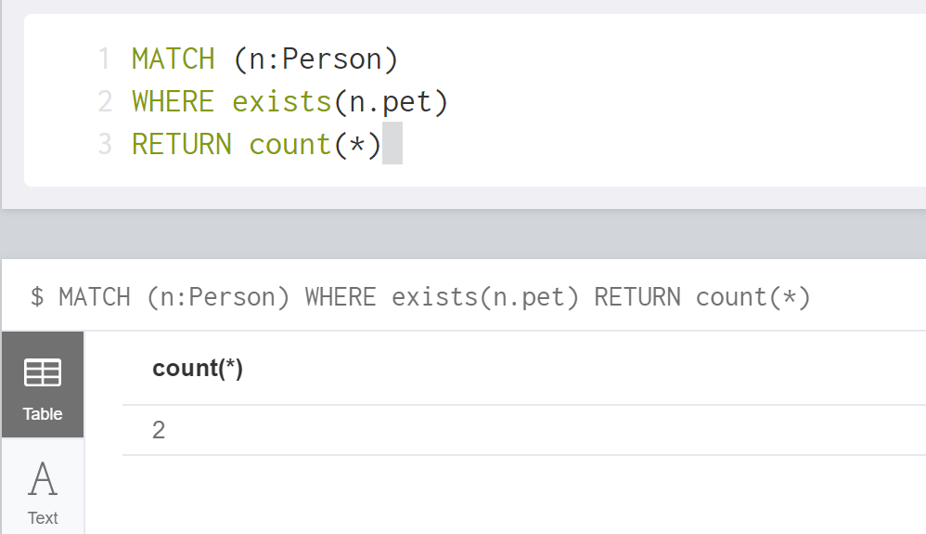
EX.8 Find Total number of persons who have pet
MATCH (n:Person) WHERE exists (n.pet) RETURN count(n)
Notes:
MATCH (n:Person) WHERE exists (n.pet) RETURN count(n)

Slide 28
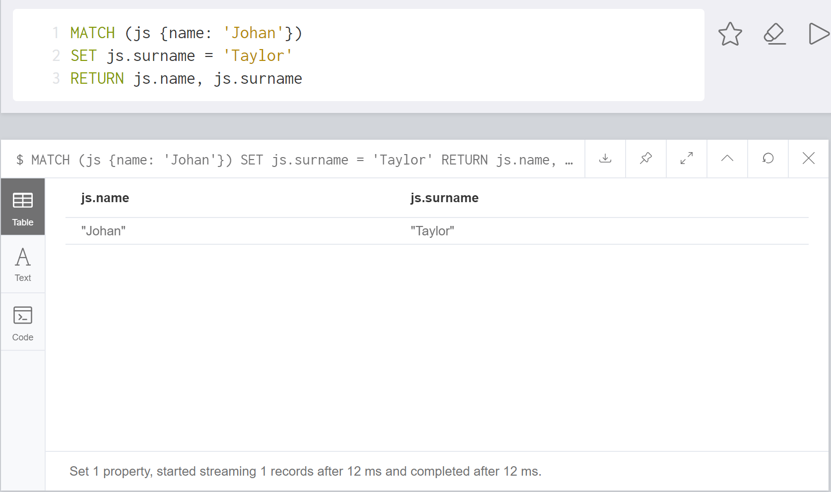
3. UPDATE
3.1 Update Node or Relationship Property
EX.9 Set Johan’s surname to be ‘Taylor’ and age =40
MATCH (js {name: 'Johan'})
SET js.surname = 'Taylor', js.age = 40
RETURN js

Slide 29
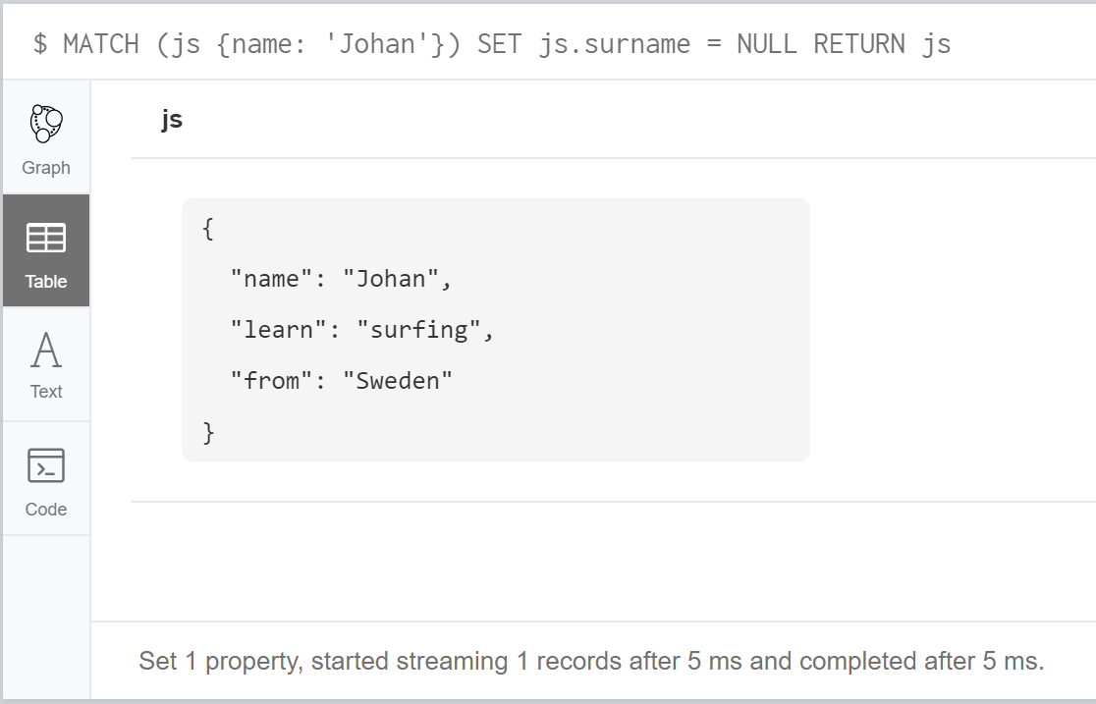
(1) If you set a property with NULL value = removing the property
EX.10 Set Johan’s surname to be NULL means removing the surname
MATCH (js {name: 'Johan'})
SET js.surname = NULL
RETURN js
BEFORE
AFTER

Slide 30
(2) Set mutate properties using +=
Any properties in the map that are not on the node or relationship will be added.
Any properties not in the map that are on the node or relationship will be left as is.
Any properties that are in both the map and the node or relationship will be replaced in the node or relationship.
However, if any property in the map is null, it will be removed from the node or relationship.

Slide 31
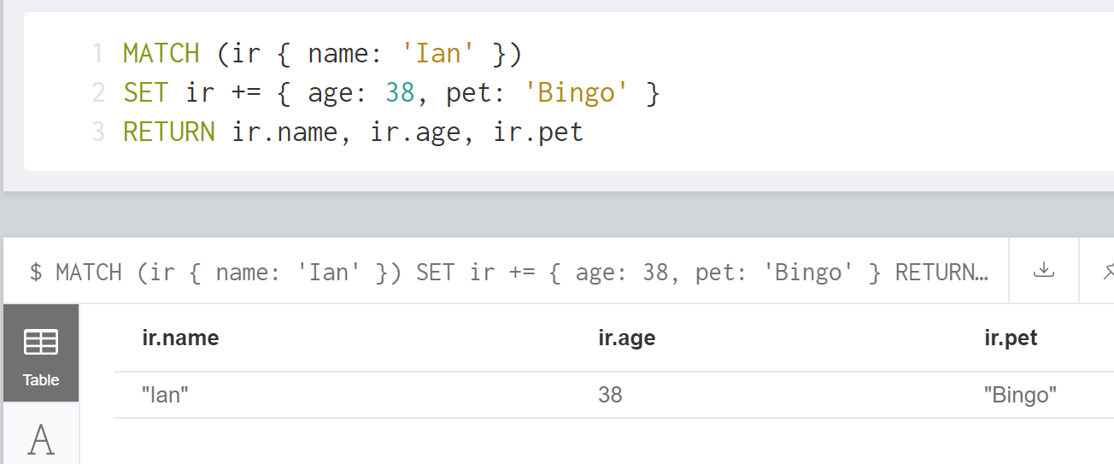
EX.11 Update Ian age and pet using +=
MATCH (ir { name: 'Ian' })
SET ir += { age: 38, pet: 'Bingo' }
RETURN ir.name, ir.age, ir.pet
BEFORE
AFTER

Slide 32
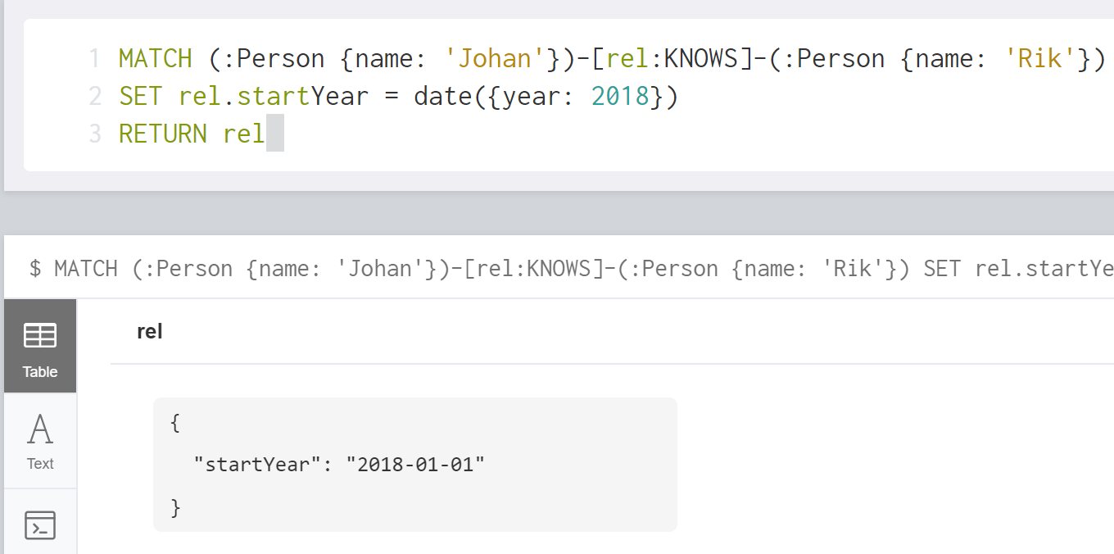
EX.12 Update relationship KNOWS to specify that Johan has known Rik since 2018
MATCH (:Person {name: 'Johan'})-[rel:KNOWS]-(:Person {name: 'Rik'})
SET rel.startYear = date({year: 2018})
RETURN rel
AFTER
BEFORE

Slide 33
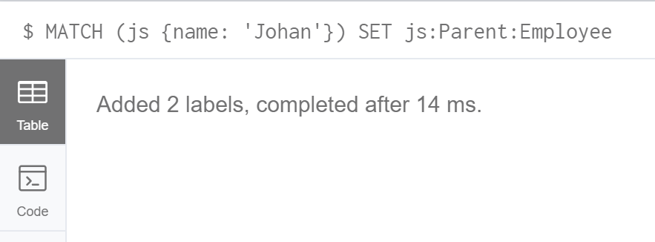
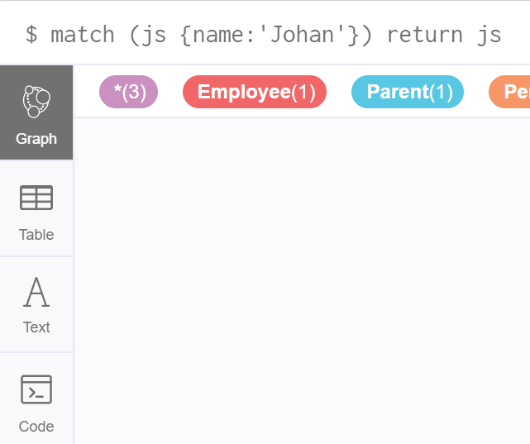
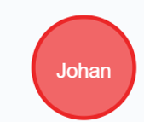
3.2 Update Node Label
Use SET to set Label(s) to a node
EX.13 Update Label for Johan to be Parent and Employee
MATCH (js {name: 'Johan'})
SET js:Parent:Employee

Slide 34
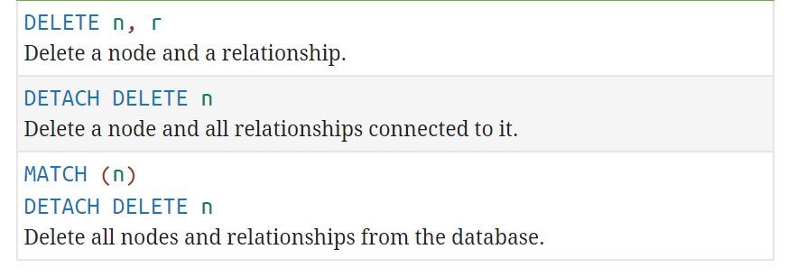
4. DELETE

Slide 35
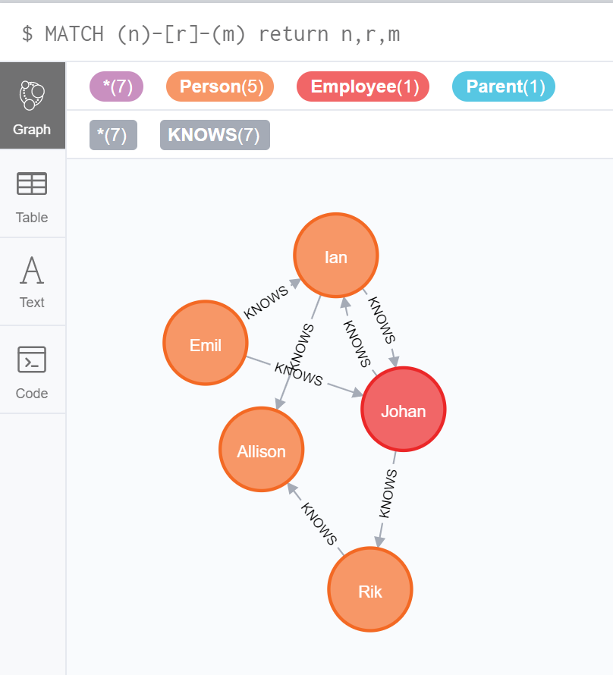
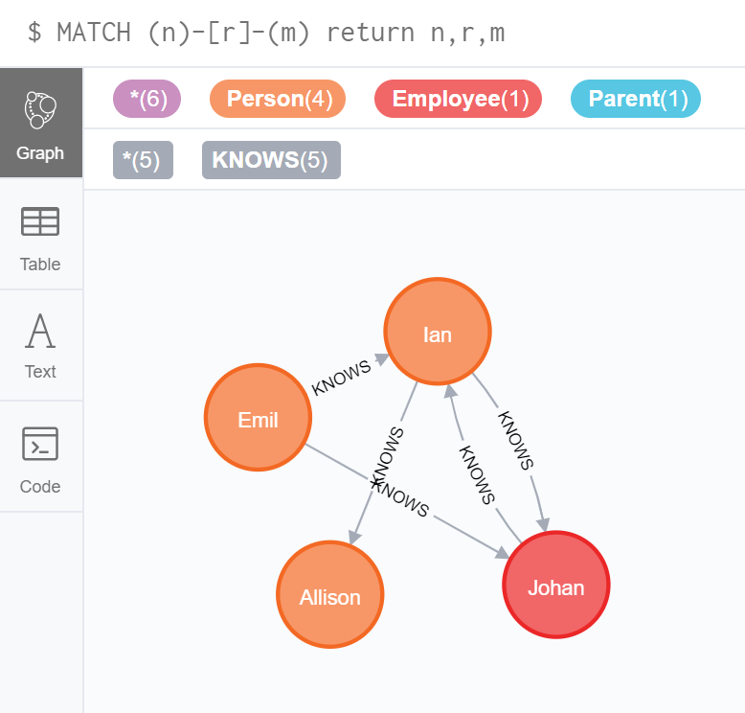
4.1 Delete a specific node
EX.14 Delete Rik node
MATCH (x {name: 'Rik'})
DETACH DELETE x
BEFORE
AFTER
Notes:
Verify: MATCH (n)-[r]-(m) return n,r,m

Slide 36
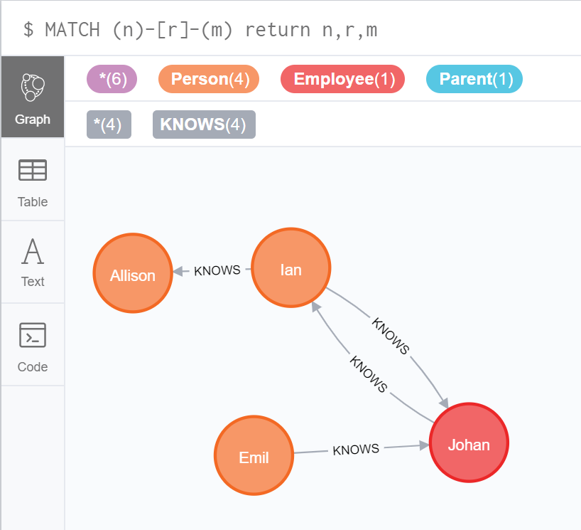
4.2 Delete a specific relationship
EX.15 Delete Rik node
MATCH (y {name: 'Emil'}) -[r:KNOWS]->(ir{name:'Ian'})
DELETE r
BEFORE
AFTER
Notes:
Verify: MATCH (n)-[r]-(m) return n,r,m

Slide 37
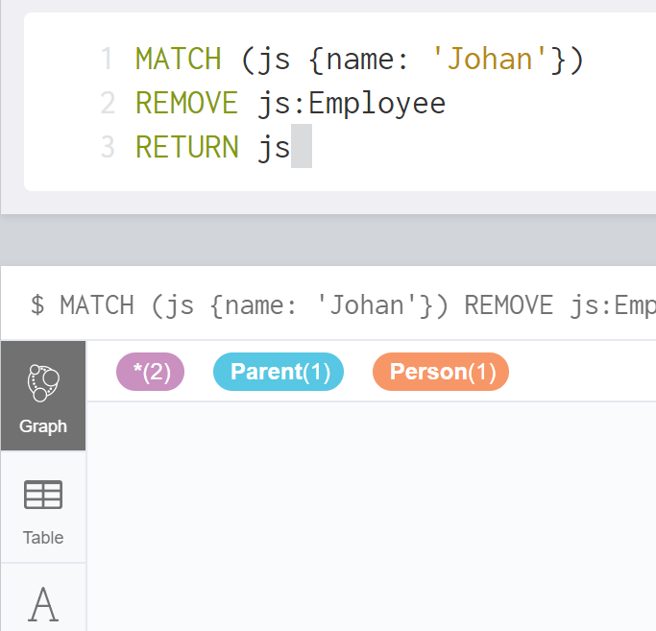
4.3 Remove Label from a node
EX.16 Remove Label Employee from Johan
MATCH (js {name: 'Johan'})
REMOVE js:Employee
RETURN js
BEFORE
AFTER
Notes:
Verify: MATCH (n)-[r]-(m) return n,r,m

Slide 38

4.4 Remove a property
EX.17 Remove age property of Johan
MATCH (js {name: 'Johan'})
REMOVE js.age
RETURN js
Notes:
Verify: MATCH (n)-[r]-(m) return n,r,m

Slide 39
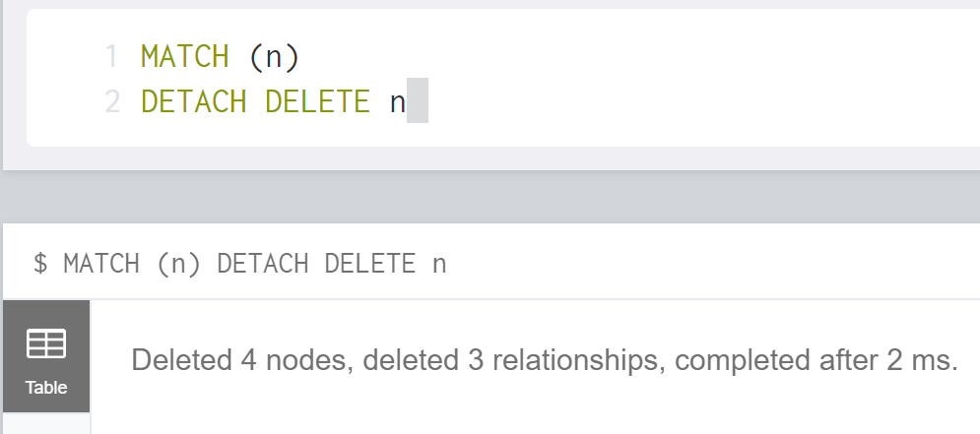
4.5 Delete ALL nodes
EX.18 Delete ALL nodes
MATCH (n)
DETACH DELETE n
Notes:
Verify: MATCH (n)-[r]-(m) return n,r,m

Slide 40
SPEED TEST
Play on Kahoot!!
1. Go to www.kahoot.it
2. PIN 7171670
3. Nickname = your studentID (e.g. st120200)
4. Click OK

Slide 41
Relationship in Neo4j can be represented by _____.

Slide 42
References
https://neo4j.com/docs/cypher-refcard/current/
https://neo4j.com/developer/
https://neo4j.com/docs/cypher-manual/current/clauses
https://neo4j.com/docs/cypher-manual/current/introduction/#cypher-introduction
https://neo4j.com/developer/guide-sql-to-cypher/

Slide 43

Thank You.

